Slide 1
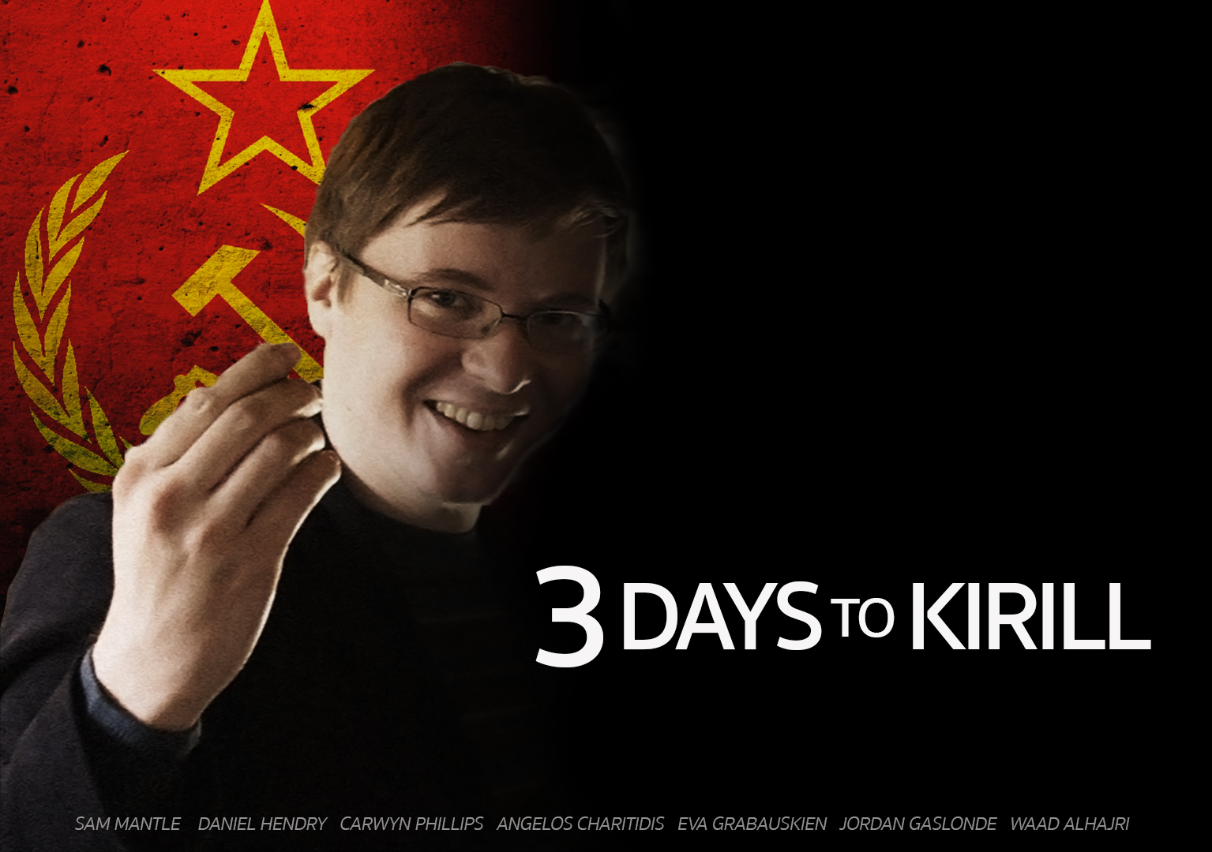
Customers of RetroBazinga Ltd.

Slide 2
What is ‘3 Days to Kirill?

Slide 3
Who are we aiming at?

Slide 4
Story & Objective

Slide 5
Map and Controls
17 rooms
Start at the Student Union
3 Key rooms (2 keys and 1 weapon)
4 Bad rooms
8 Normal rooms
Prison (final room)

Slide 6
Current status & The Future

Slide 7
Questions?
?

